Slide 1
Magnetic lens simulations
CaOH

Slide 2
Schematic
4K aperture
1 cm diameter
Lens aperture
2.5 cm
Beam shutter
1.4 cm diameter
Mot size ~2.5 cm
2.5 cm or 5 cm
Cell
Lens
MOT
10 cm or 15 cm
Vary from 1cm to 10 cm
31 cm fixed
26 cm fixed
57 cm fixed

Slide 3
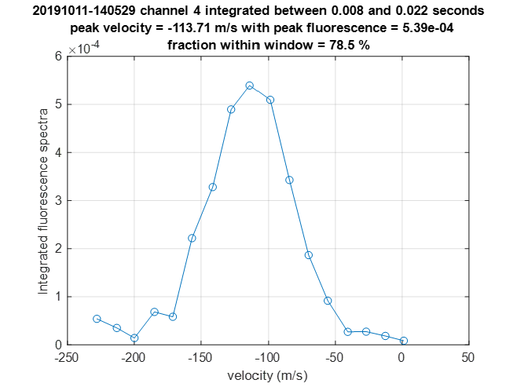
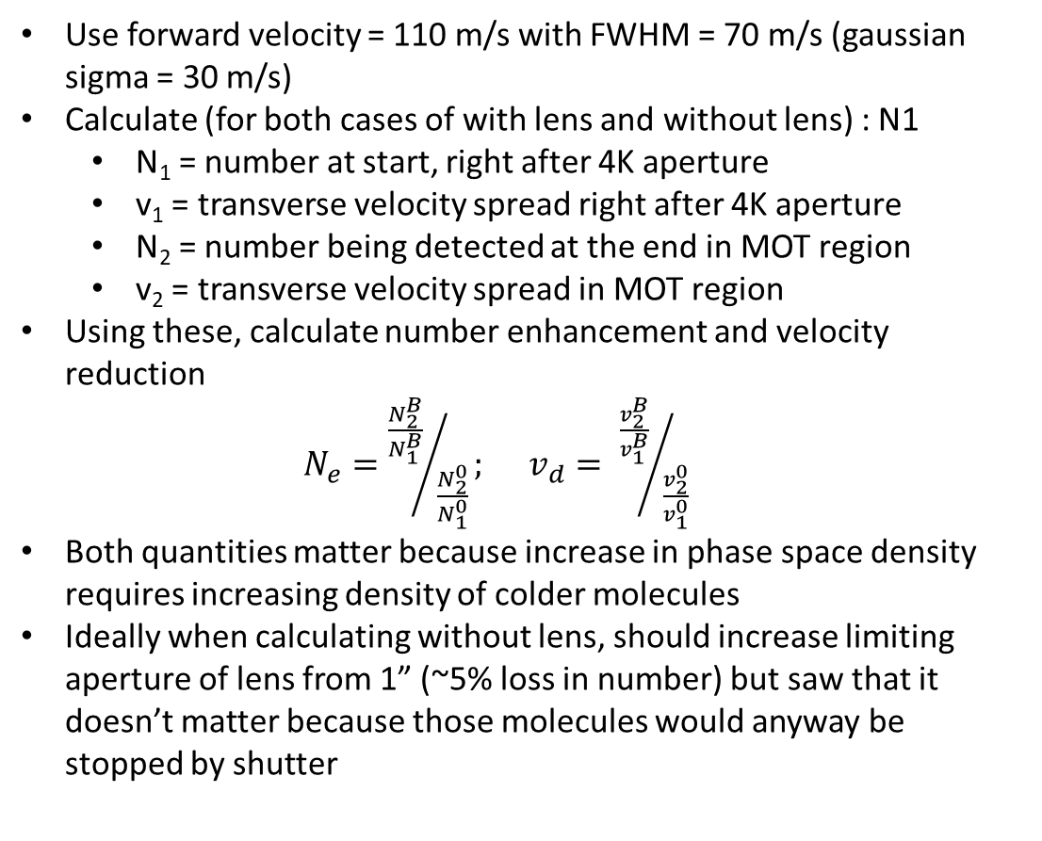
Molecule parameters
Use forward velocity = 110 m/s with FWHM = 70 m/s (gaussian sigma = 30 m/s)
Calculate (for both cases of with lens and without lens) : N1
N₁ = number at start, right after 4K aperture
v₁ = transverse velocity spread right after 4K aperture
N₂ = number being detected at the end in MOT region
v₂ = transverse velocity spread in MOT region
Using these, calculate number enhancement and velocity reduction
$N_{e}={\frac{N_{2}^{B}}{N_{1}^{B}}}/{\frac{N_{2}^{0}}{N_{1}^{0}}}; v_{d}= {\frac{v_{2}^{B}}{v_{1}^{B}}}/{\frac{v_{2}^{0}}{v_{1}^{0}}}$
Both quantities matter because increase in phase space density requires increasing density of colder molecules
Ideally when calculating without lens, should increase limiting aperture of lens from 1” (~5% loss in number) but saw that it doesn’t matter because those molecules would anyway be stopped by shutter

Slide 4
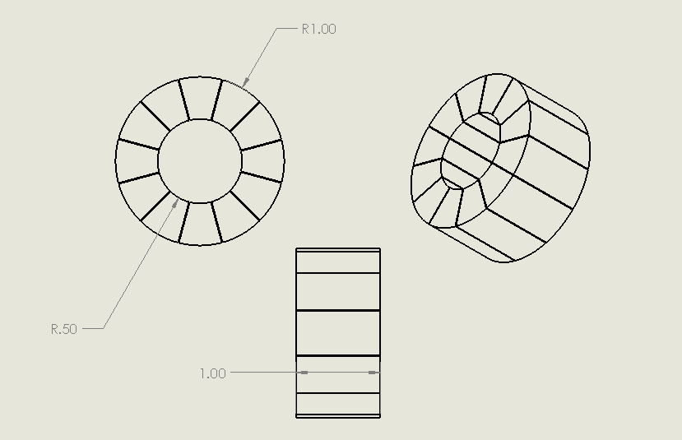


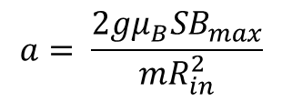
Single Halbach array
Cut along x for y, z = 0
$$B_{max}$$
$R_{in}$= 12.7mm
(inches)
$$a= \frac{2gμ_{B}SB_{max}}{mR_{in}^{2}}$$
gradient along x for y, z = 0

Slide 5
Issue why enhancement is small
Clearly see shift in center towards negative velocity. Not seem without magnet so its not gravity
Cell to detection = 68cm
4K to shutter = 24cm
Detection diameter = 1cm
Without lens, N = 670
With lens, N = 4100
enhancement = 6.1
Happens because of slight asymmetry in comsol gradient : realized that the resolution on the comsol export was too low and the gradient in the center was not going to 0. Fixed that by
Reducing the size of the envelope volume over which simulation happens
Exported a regular grid of 200x200x200 points instead of 100x100x100 points

Slide 6
After correction of B-field – Vary 4K to shutter distance
About 15,000 molecules start out after 4K aperture
Cell T = 1.5K, v_f = 110m/s
Distance between shutter and detection fixed at 34cm
Detecting only in 1cm diameter
Double Halbach array fixed at 10cm from 4K aperture

Slide 7
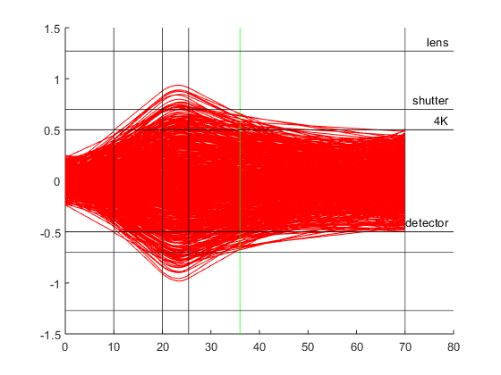
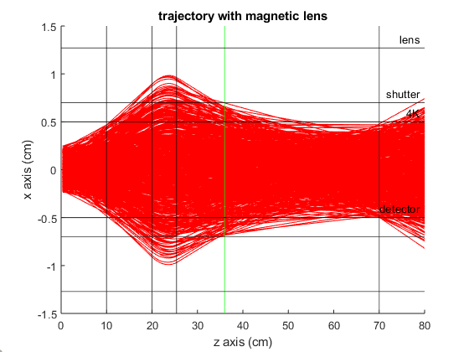
Comparing different methods
Slow : iterate over each trajectory
Fast : matrix operation for all trajectories
10 x (675/67, start with 1e5)
10 x (680/60, start with 1e5)
Old code
New code

Slide 8
Averaged force profiles

